Slide 1
Data Sharing
04/24/2024

Slide 2
Who is sharing data: Everyone
All VAI groups are sharing data
Internal Sharing
Between lab members
Cores to Labs
Lab to Lab
To all VAI users
External Sharing
From a collaborator to VAI
From VAI to a collaborator
External Core customers
Notes:
Tons of sharing between labs.
Big uptick in sharing
Maybe there was always sharing and the rules are more strict now so people are being forced to use official channels?
Cores do a lot of external work

Slide 3
Goals:
To help you answer the question “Can I share this data?”
A Brief overview of the tools available to share data
Pros/cons of each tool, and when to use one over another.
Technical demonstration of GLOBUS
We will walk through live demo of various sharing situations

Slide 4
When can I share research data?
Simple Answer: when there are no restrictions placed on some or all of the data by third parties
Is there an agreement with third party executed by VAI for any of the data to be shared? (i.e. UK Bio Bank, DBGAP, All of Us, etc.)
Did you have to click ‘accept’ to terms when downloading data that will be included in sharing?
Nuanced Answer: consider the data you are sharing
IRB restrictions, PHI, HIPPA, Intellectual Property obligations, Bayh-Dole, etc.
If in Doubt Ask BDTT
Notes:
Jerry
Q’s for Jerry depending on time:
How do I know if there was an agreement?
Who’s responsibility is it for knowing about an agreement.
How to contact BDTT? Whom?

Slide 5
VAI data sharing tools
Email: small files under 50MB. Only mainstream file types.
Pros: Easy, universal, any device
Cons: other places my remove attachments, hard to track, no confirmation
Researchtemp/hpctmp: A local file share to temporarily store data
Pros: Connects to VAI computers and instruments
Cons: only works with certain computers, only internal use. No long-term storage
Teams/Sharepoint: sharing internal office documents
Pros: Great for documents: revision tracking, full paper trail.
Cons: not for huge amounts of data. Mainly for VAI internal use.
OneDrive: Sharing smaller data and documents internal/external
Pros: Great for documents and smaller files. Recently was enabled to share with external users.
Cons: not for huge amounts of data. Can be slower
Globus: Heavy lifting between institutions
Pros: The fastest, most reliable and compliant way to move data between institutions.
Cons: Must know how to use the globus app (hint: we’re showing you how today!)
Notes:
We assume they already are using team and sharepoint.
Ask Mowry about teams vs sharepoint vs onedrive

Slide 6
OneDrive
CloudBased file sharing and sync
Similar to DropBox, iCloud files, Google drive?
You can share with VAI colleagues and external people
External sharing has recently been enabled
The external party does not need a VAI account, you can share to anyone with an email.
You can share by person’s name or “copy a link”
Everyone at VAI is already set up and ready to use.
Everyone gets 1TB of space!
This can be expanded to 5TB and beyond on a case-by-case basis.
You can run the app which keeps folders sync’ed automatically. (like dropbox or icloud)
Access from work computer, home computer or mobile
GO TO: https://onedrive.live.com/login/

Slide 7
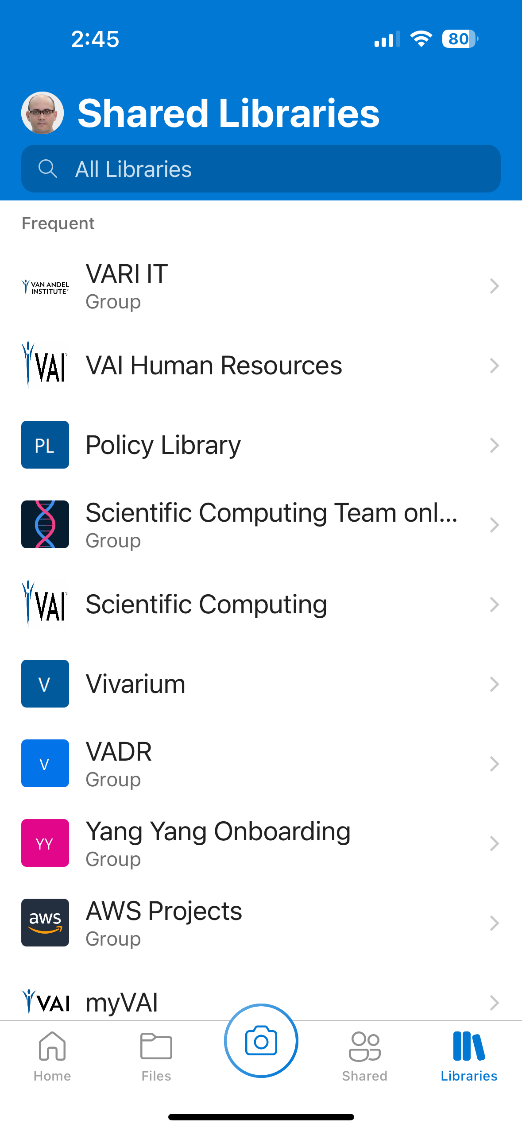
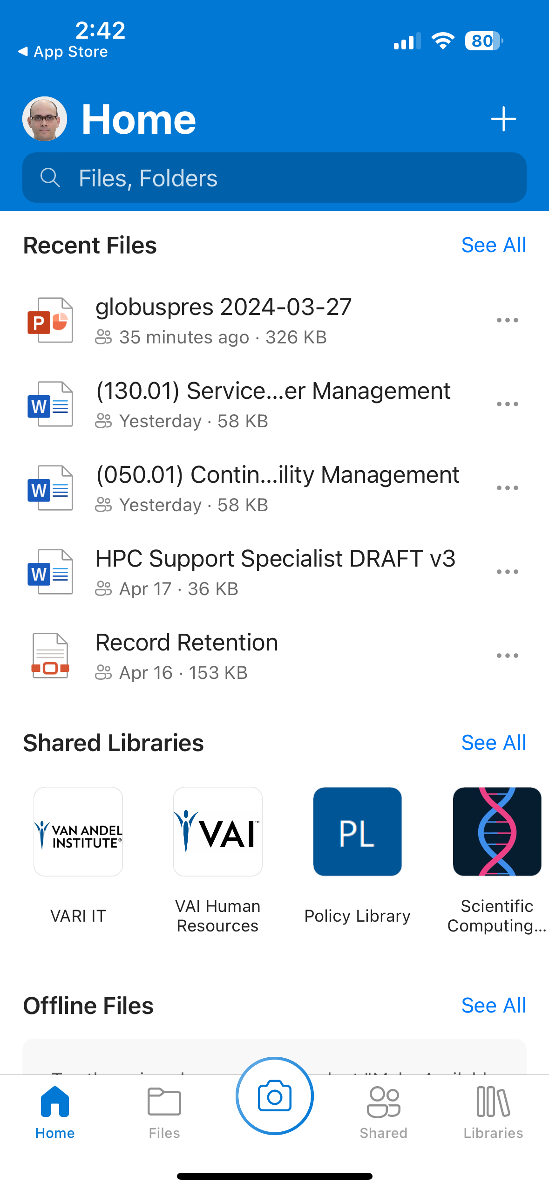
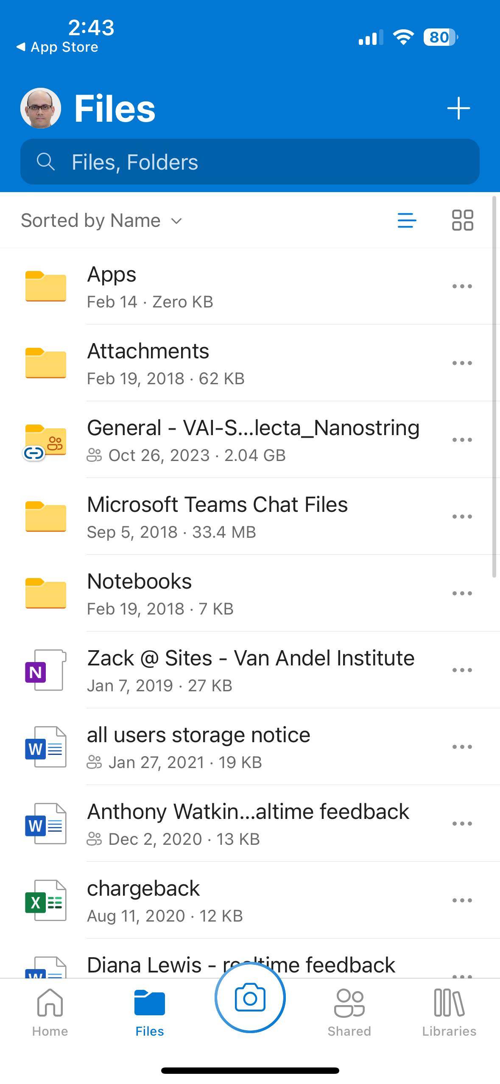
OneDrive: View your files
Notes:
Your sharepoint and teams files are also here
Compare to my experience with dropbox

Slide 8
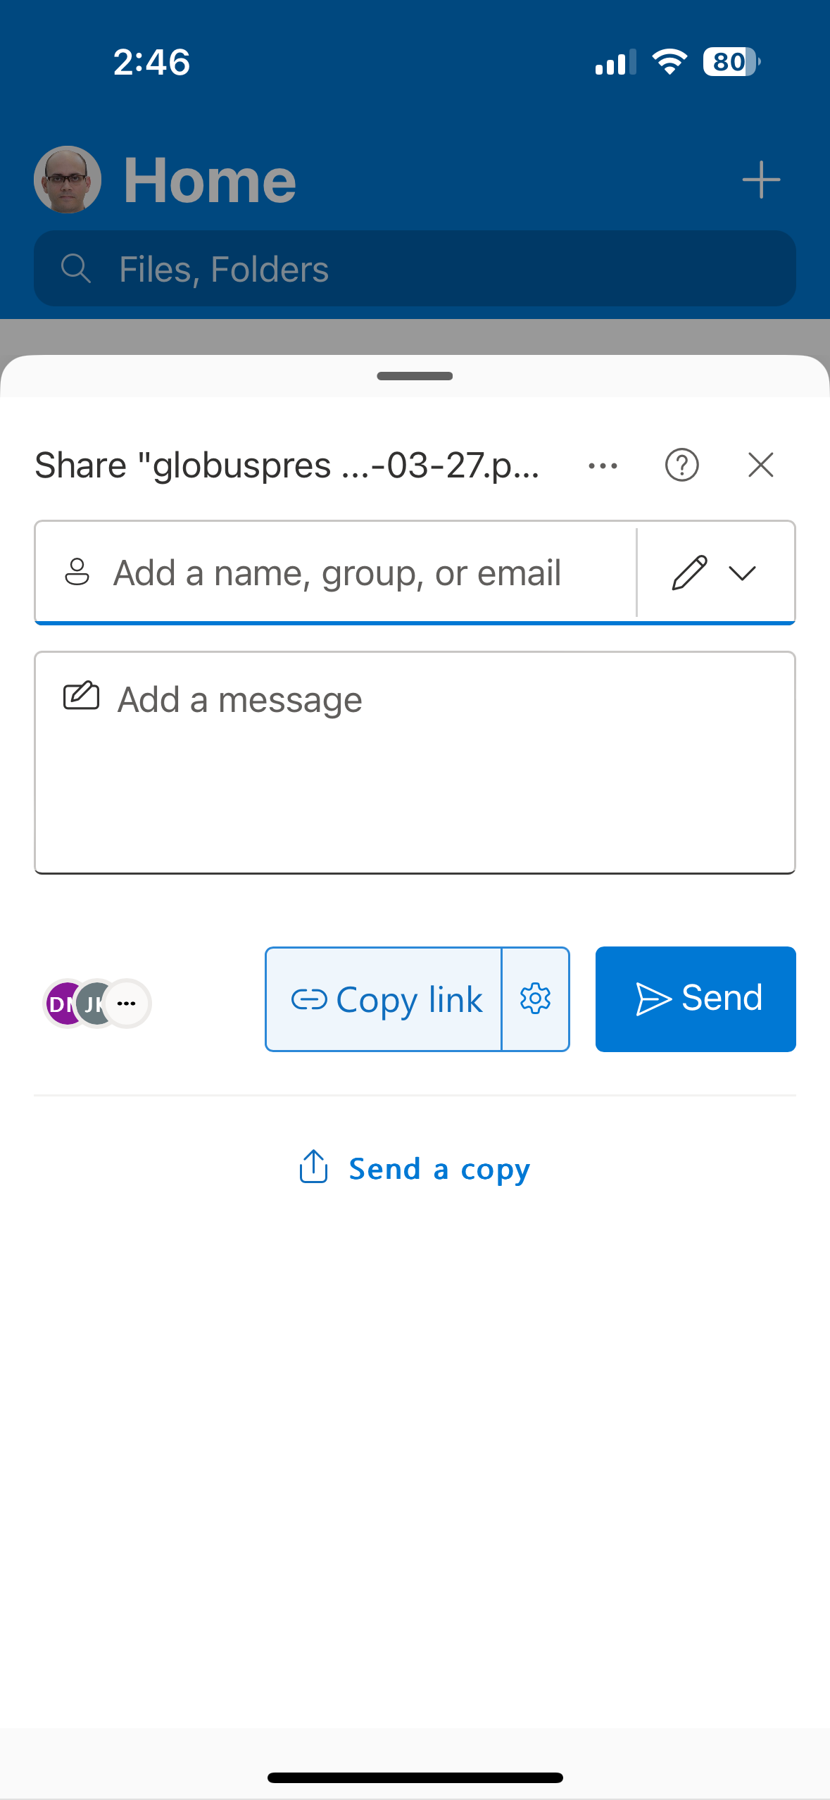
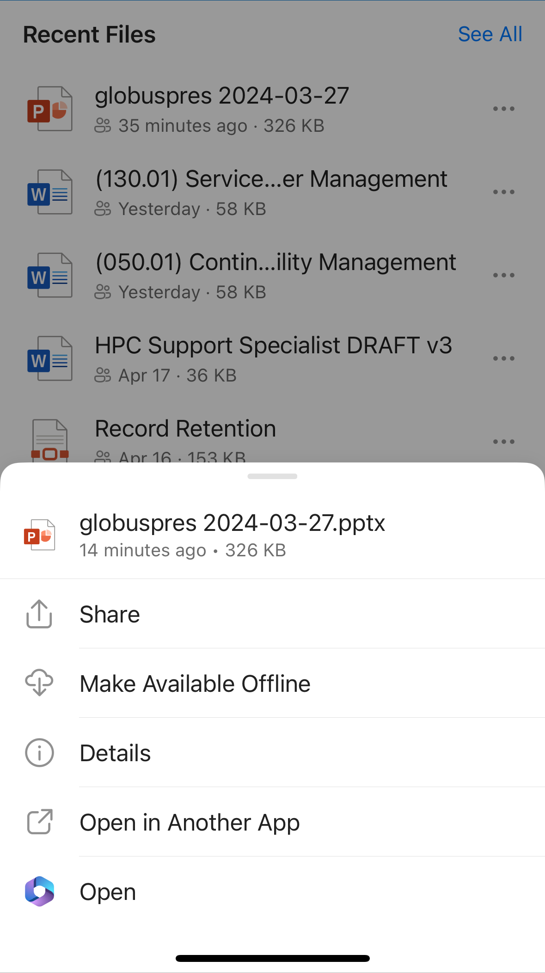
OneDrive: Share your files

Slide 9
SharePoint/Teams
CloudBased file sharing and sync
A team in Teams is the communication mechanism for SharePoint.
Files stored on a team in Teams is uploaded to a folder for the channel in the SharePoint site's Document Library.
Sharing externally works like OneDrive.
Everyone at VAI is already set up and ready to use.
Site/Team gets 60 GB of space.
This can be expanded by request and is monitored to help with expand sites as needed.
You can run the app which keeps folders sync'd automatically. (OneDrive)
You can create shortcuts to document libraries to access files from file explorer
Files are only downloaded when opened.
Access from work computer, home computer or mobile
SharePoint: https://vanandelinstitute.sharepoint.com/_layouts/15/sharepoint.aspx
Teams: https://teams.microsoft.com/
Notes:
David Presenting

Slide 10
Globus https://www.globus.org/
Globus is a tool and a file sharing consortium
Originated at UChicago/Argonne. Sponsored by NIH, NSF, DOE and more
VAI is a vetted, fully licensed member of the consortium, along with most other national academic institutions and gov.
Many European institutions are members as well
Not many Asian institutions.
Globus allows for bidirectional sharing directly between storage
Data appears on research storage, no need to copy to/from laptop etc.
Globus is very fast, can handle petabytes, and has strong security.

Slide 11
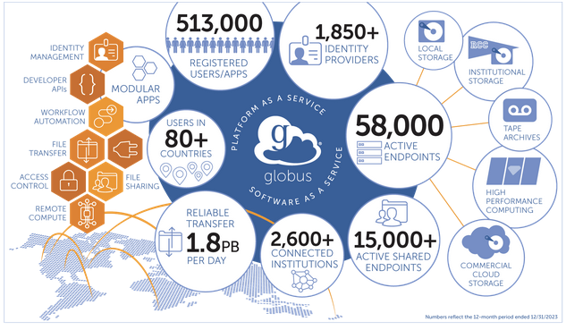

Slide 12
Scenario 1: Sending data to a collaborator
Make sure the data is in the research storage collab area
Using linux shell, or mac/win to do this:
Login to the globus.org site
Share
Example: Globus is the preferred method of sharing data between VAI and MSU. Data shared from VAI can be transferred directly to MSU research storage.
Notes:
Collab is not long term storage

Slide 13
Scenario 2: Receiving data
You will get an email from globus saying data has been shared with you
Login to the globus.org site
Initiate the transfer
Data appears in research storage.

Slide 14
Using globus to share with non-consortium members
While its easiest when both VAI and your partner are both members of the globus consortium, this is not a requirement.
VAI pays to license “globus server”. This allows VAI to share with individuals who do not have a globus presence or are a private party.
Example: Spectrum/Corewell Health
Share as usual to their email address, but when they get the notification, they will be asked to login to the globus website.
They can use ”login with gmail” or github, or create a login with another email.
They will be able to download to their current device.

Slide 15
Other Globus tricks
You can share with multiple people at once
You can create public datasets
Globus will not automatically delete your shares.
When you are done, you must log in and remove them

Slide 16
Questions
Contacts
Policy
Sharepoint
OneDrive
Globus
Help: servicedesk@vai.org
The fastest way to get help. Routed to the appropriate person with tracking.
Today’s Presenters and their area of expertise
Zack Ramjan: HPC, linux, storage
Jerry Callahan: Contracts, Policy, Institutional strategy. Collaboration with external entities
David Mowry: Sharepoint, OneDrive, Microsoft Cloud tools.
Jason Kotecki: Globus, Research Storage, Data transfer, Linux

